Slide 1
‘Die angeborenen Defecte der Kammerscheidewand des Herzens’
Z. klin. Med., 32, Suppl.- Heft, 1-28, 1897.
Notes:
The congenital ventricular septal defects of the heart

Slide 2
Victor Eisenmenger
[1864-1932]
Austrian Physician
1897

Slide 3
The time frame
1888-Etienne Louis Arthur Fallot
1944- First BTT shunt surgery

Slide 4
The case of V Eisenmenger
32/M, powerfully built man
H/o cyanosis+
Moderate breathlessness since infancy
Jan 1894 worsening dyspnoea
Aug 1894 → Frank HF
O/E cyanosis, clubbing, polycythemia
Distended liver, extensive edema
Loud systolic murmur 3rd & 4th LICS
Basal diastolic murmur from pulm incompetence
Improved with rest & digitalis
Nov 13 massive hemoptysis→ sudden collapse & death

Slide 5
Pitfalls
Cyanosis was peripheral rather central
SM to left → right shunt
Attributed the rise in pulmonary vascular resistance to multiple thrombosis and pulmonary infarction –Lt UL & Rt LL
Reasons for misinterprentation:
Cyanosis since birth → couldn’t attribute it to reversed shunt due to PH
Misleading JVP findings
Notes:
VE was unaware of rt to lt shunt

Slide 8
Conflicting Hypothesis
1924 - Abbot & Dawson
1947 - H Taussig
1950 - Brown

Slide 9
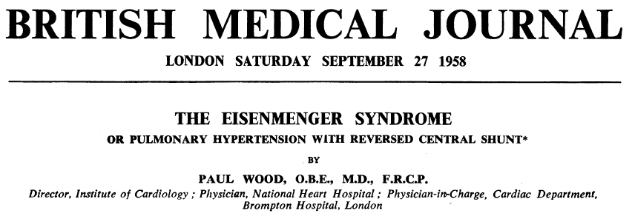

Slide 10
Paul Wood
3
1907
Born in India
Died in 1962
AWMI
Coined the term “Eisenmenger Syndrome”

Slide 11
1947 - Bing et al
5 cases
Pulm pressures at systemic level
Bidirectional shunt
1950 - Burchell
1950, 1952 - Wood
1951 – Selzer
1953- Soulie

Slide 13
The syndrome described is Pulm HTN with Reversed or Bidirectional Shunt
It matters very little where the shunt happens to be

Slide 15
Total period -11 years
Total cases – 127
Death – 18
Autopsy – 15
38 autopsy results from Britain
Total – 53 cases for study

Slide 16
Age

Slide 17
Sex

Slide 18
Onset of ES

Slide 19
Symptoms
Effort intolerance +
PDA- ES - best tolerated
Angina, Syncope, Hemoptysis, CHF

Slide 20
Hemoptysis
Eisenmenger Complex
33%
Never before 24yrs
100% by 40yrs
25% of ASD-ES
4% of Pri PAH
Large hemoptysis – imm death -29% of 42 deaths
Notes:
Pulm infarction from thombosis
Late onset – atherosclerosis polycythemia

Slide 21
5 Facets of Arterial desaturation
Cyanosis
Clubbing
Polycythaemia
Differential Cyanosis –seen in 50% of PDA-ES
Squatting
Uncommon, when + usually a/w VSD

Slide 22
Jugular Venous Pressure & Pulse
Commonly normal
Small dominant a wave – 20-25% of each subtype
Giant a wave seen in 18% of ASD-ES
Right atrial Gallop
38% of ASD-ES
2-3% of others
S2 – single in 55% of VSD-ES
Close split S2- indeterminate
Obvious or wide split – favoured ASD-PAH -86% of cases

Slide 23
ECG
Paroxysmal AT or flutter(rarely fibrillation)
20% of ASD-ES
None in VSD-ES
5% of PDA-ES
RV dominance seen in 80% of ASD-ES
44% when shunt elsewhere
Some evidence of LV enlargement in addition to RV with large biphasic clx in chest leads→ PDA-ES
Q in V5,V6
Present in 82% of PDA-ES
Absent in 87% of ASD-ES

Slide 24
CXR
Rt Aortic Arch - 16% of VSD-ES
Rounded shadow overlying the aortic knuckle [double edged app → representing the duct itself]
Ductal calcification
Cardiomegaly – MC with ASD-ES 85%
Diminished Pulm Vascular markings beyond the dilated main hilar branches >60% all grps

Slide 25
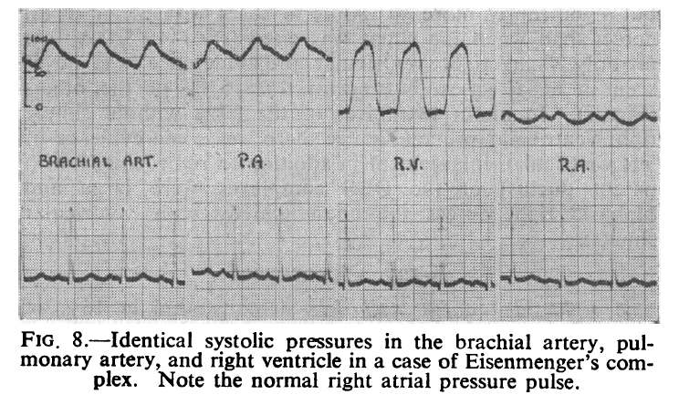

Slide 26
Eisenmenger Syndrome-Definition

Slide 27
Eisenmenger Complex
“Maude Abbott” coined the term
VSD with reversed shunt in the absence of Pulmonary stenosis
Rt to Lt shunt
Initially attributed to the over riding aorta
Later found to be d/t increased PVR

Slide 28
Dye dilution Curve

Slide 29
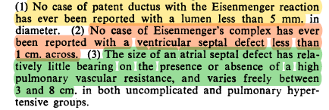
Size of the defect
PDA <5mm
VSD <1cm
ASD ~ 3cm

Slide 30
Elastic arteries
In fetus / neonates:
Elastic fibers in PA – long & densely packed ~ Aorta
Fall in PVR→ Fibers break,shorten & loosen up
PA in VSD & PDA
Resembled foetal (aortic ) pattern
In ASD & all acquired PAH
Normal PA appearance
- Heath[1958]

Slide 31
Pulm HTN in Eisenmenger Syndrome
VSD & PDA – from birth
ASD – must be acquired

Slide 32
Muscular Arteries:
<1mm diameter
Persistence of fetal type of muscular artery
Contributed to the high pulmonary vascular resistance
Arterioles:
<100u in diameter
endothelium, single elastic layer & adventitia
not supplied by muscle
Thin walled & dilated

Slide 33
Overriding of Aorta
VSD - 1 of 12
may lead to high PVR & reversed shunt
An overriding aorta or its physiological equivalent - absent in 7 of these conditions
PVR – High → SpO2 ~ 80%
Eisenmenger complex –classical
Defect in muscular IVS
There can be NO OVERRIDING OF AORTA

Slide 34
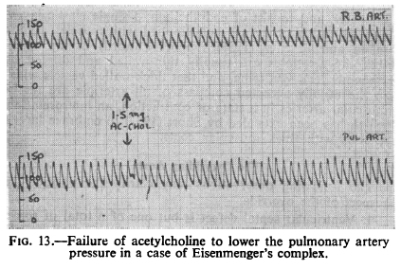
Experimental Pathophysiology

Slide 35
Course & Prognosis
ES begins @ birth or during the first 2 yrs when the shunt is post tricuspid
ES – typically acquired when the shunt is inter atrial
Cyanosis or Dyspnoea – no appreciable change till adolescence
Hemoptysis → signal for the downward trend

Slide 36
Mode of Death
Cause of death- known in 42 cases
MCC- Hemoptysis -29%
Pulmonary infarction from arterial thrombosis
Rupture of a thin walled dilated arteriole immediately distal to end of a thick muscular artery
Rupture of aneurysm of PA (Most unusual)

Slide 38
Of the 18 + 38 deaths, [avg age of death]
33yrs→for both Aortopulmonary & VSD
36yrs→for ASD
14% - SCD presumed to be VF
26% - died from surgical attempt
17% - CHF

Slide 39
Secret of Eisenmenger

Slide 40
1.
Alan Burton, 1958
Resistance – Kinked vessels
Gnarled appearance[rough& twisted]
2.
Williams
Kinks get straightened – lowers resistance
Jaykka
Blood fills up the vascular bed- expansion
Dawes et al
Only when gaseous filling PVR decreases
Hypoxic vasoconstriction

Slide 41
3.
Dawes
Fn of thick muscular arteries
Well developed in fetal life in relation to systemic pressures
Are in a state of vasoconstriction – can be released by Ach
4.
Bayliss
Slowly tone in muscular arteries decreases as pressure decreases
Williams
Resistance decreases → Flow increases→ Vessels dilate→ Further fall in resistance
As pressure falls→ muscular arteries atrophy→ decrease the resistance

Slide 42
Pulm HTN in ASD
During the critical period of involution and relaxation of muscular arteries → no interatrial shunt
Before the shunt operates, the filling resistance needs to be considered
How soon the RV involutes sufficient enough to permit an interatrial shunt- unknown
It is slow, slower than involution of muscular arteries
Nadas
Pulm SM characteristic of increased flow not heard until the child is well past the neonatal period
Difficult for ES to set in later, pulmonary vessels are fully involuted and increased PBF follows as in others

Slide 43
Summary
Defn: - PH d/t high PVR with reversed or bidirectional shunt @ A-P or V or A level
12 diff condtions
Large inter circulatory connections
Exceeding >0.7cm in A-P
>1.5cm when interventricular
>3cm when interatrial
Obliterative pulm vascular disease d/t “endateritis fibrosa”
Thrombo-obstructive lesions are late

Slide 44
 | ASD | VSD | PDA
SEX RATIO | 1: 3 | 1: 1 | 1: 2
DOE | GRADE 3 | GRADE 2 | GRADE 2
ONSET | LATE | EARLY | EARLY
CENTRAL CYANOSIS CLUBBING, POLYCYTHEMIA | 75% | 90% | 30%
DIFFERENTIAL CYANOSIS | -- | --- | 50%
DOMINANT a OR LARGE V in JVP | 1/3RD | RARE | UNUSUAL
RV LIFT | CONSIDERABLE ( NEVER ABSENT) | SLIGHT OR MODERATE (ABSENT IN 10%) | SLIGHT OR MOD. (ABSENT IN 10%)
S2 | OBVIOUSLY SPLIT | SINGLE OR CLOSE SPLIT | CLOSE SPLIT
ECG-P PULMONALE RVH Q IN V5,V6 XRAY – RAE RT SIDED AORTA LEFT SVC CALCIFIED DUCT PROMINENT AORTIC KN. | >50% 2/3RD -- 60% -- -- -- -- | <50% 1/3RD 15% 15% 16% 8% -- SEEN | UNUSUAL 1/3RD 50% 15% -- -- RARE SEEN

Slide 46
188 patients
Median follow up period - 31years
64 males, 124 females
Mean age - [33 +/- 12.8yrs]
CHD
Simple – 128
ASD-21, VSD-71, PDA-36
Complex – 60
TGA+VSD-8, AVCD-23,DORV-4, SINGLE VENTRICLE- 9, TRUNCUS- 11, CCTGA+VSD -4

Slide 47
Results
Complex CHD
earlier deterioration, shorter survival
20.2% (38) atleast one episode of hemoptysis between 20-40 years
13.2% (25) had pulm thromboembolism
7.9% (15) had stroke
3.7% (7) had cerebral abscess

Slide 48
Cerebral complications - impaired the QOL
Venesection
Target Hb <18g/dl
did not reduce cerebral complications
20% caused IDA
Non cardiac surgery – 23.5% of deaths

Slide 49
Pregnancy
39 Pregnancies in 22 pts
15 pregnancies - terminated
14 pregnancies - Spontaneous abortion – (35.8%)
Only 10 continued
All delivered before 37wks – 9 LSCS, 1 NVD
Clinical deterioration in all post partum
3 deaths –
2 cases - 3rd & 14th day post LSCS
1 case - 10 days after NVD
10 babies survived – all SGA – one PS, one COA

Slide 50
Total deaths- 61
Sudden death – 29.5%
SCD MORE D/T ARRYTHMIAS THAN HEMOPTYSIS
Heart failure – 22.9%
Hemoptysis – 11.4%
8 cases – Heart Lung TX
5 died between 1 week and 4 years

Slide 52
1976-92
Total - 201pts
Mean age of presentation - 19yr
12 anatomic lesions
MC - VSD(33.3%), ASD(29.85%), PDA (14.3%)
20 deaths in follow up period of 54 +/-54 mths
SCD (30%), CHF(25%) & HAEMOPTYSIS(15%)
5YR,10YR,15YR SURVIVAL was 86.95%,79.6%&76.9%
Level of shunt didn’t influence survival
Prognostic factors identified were
Syncope, elevated RAP >8mmHg, SpO2 < 85%

Slide 53
THANK YOU

